Slide 1
CS 341 Lab 6
Fall 2020

Slide 2
Lab 6
Goal: create an outdoor light for a driveway or parking lot
motion sensor to detect a car or person
light sensor to determine whether it is dark or not

Slide 3
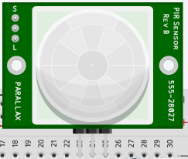
Infrared Motion Sensor
Detects motion by looking at changes in heat
gives us a digital signal
1 = something detected
0 = nothing dected

Slide 4

Photoresistor
A variable resistor that changes based on light detected
To read it, we will need an analog input

Slide 5
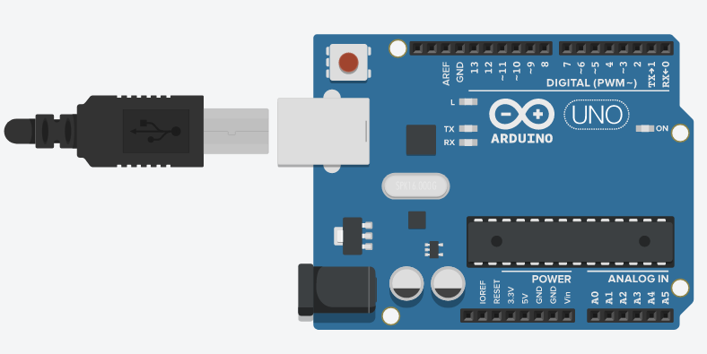
Analog Pins
Read in a value between 0V and 5V
In code, this is interpreted as a value between 0 and 1023
Can also be used as additional digital pins
Example:
analogRead(A0);

Slide 6
Lab 6
Complete the circuit
Implement the logic in loop()
Loop() {
if (motion) {
if (light < 200) {
// light bulb on
}
} else {
//turn the light off if there's no motion
}
delay(200);
}

